Slide 1
Analytics Stream Draft 2016-09-27
September 2016 / Peter Tillegreen

Slide 2
Content
Learning Analytics stream purpose
Questions to the program management
Transformation program streams
Learning analytics and the Enterprise architectural model
2016 Delivery Plan
Analytics related project portfolio
Project portfolio – suggested phasing
Roadmap
Learning Analytics architecture layers
Detailed architecture input per layer
Business Stakeholders
Parked questions
Support slides
Learning Analytics defined
2013 LA model (From F4F)
EvaluateIT framework

Slide 3
Purpose of the Learning Analytics Stream
Suggested :
The primary purpose of the learning analytics stream is to secure:
Clear Program level portfolio view on analytical projects and subprojects within program streams and in wider group level OU/L&D ecosystem.
Adequate coordination or conflict resolution between parallel initiatives
A shared common learning analytics architecture within which current and new initiatives can be seen and prioritized.
It is to be decided if the stream should have project responsibility for the portfolio of projects related to analytics

Slide 4
Questions to the program management
Management / Anchoring of stream?
Who should manage and where to anchor this stream / activity portfolio?
Need close collaboration with and budget from ITICS as stream is 100% dependant on Technological infrastructure, Information systems and information governance and security being handled
Ressourcing / staffing
If stream shall act as more than high level coordination it would need ressources (budget/staff) to do so.
Alternative is to keep projects currently launched running independently and only coordinate in a minimal model to avoid waste of efforts.
Stream support
Even if only minimal model it would be worth considering getting advice from I&D on best practice for structuring analytical capability within an organization like ours, and a realistic T-Map to develop the capabilities within OU / L&D.
NGL / CD / ITICS / L&D Operations (HRO) to be consulted

Slide 5
Key transformation streams to support the delivery of the target Group Learning organisation
Management
New Ways & Innovation
Operations
New substream agreed in Transformation workshop 19-20/9 2017
Group Learning Governance
Digital Age
Ways of Learning
Group Learning Structures
New Group Learning Governance
Annual Engagement cycle
Group Learning ways of working
Digital Age Learning Approaches (formal & social)
The Lab services and offers (around DAL)
Physical International Campus Learning events
University and L&D organization structures
Roles & responsibilities
New skills and capabilities
Finance, Budget & Business Impacts
Analytics
Learning Services
Digital Age Learning Technologies
Joint budgeting & reporting for University & L&D
Finance Process Efficiency & Optimization
Business Impact Analytics & Evaluation
Learning Reporting
Global Learning Contract Management
HRO
Learning IT Strategy & Architecture
Tools & Platforms (Social Learning Platform
Technology Roadmap
Business Impact Analytics & Evaluation
Analytics Business requirements
Analytics enterprise architecture
Former IGATE University Integration
Change & Communication
Integrate around the 3 key areas Key Roles, Content & Infrastructure
PoV on leveraging India Campus
Overall Program Management
University and L&D Change Management
Transformation Communication
These streams are overseen by a Transformation Steering Committee presided by Philippe Grangeon and composed of Sandrine Humphrey, Stephan Paolini, Steven Smith and Jaydeep Lal.

Slide 6
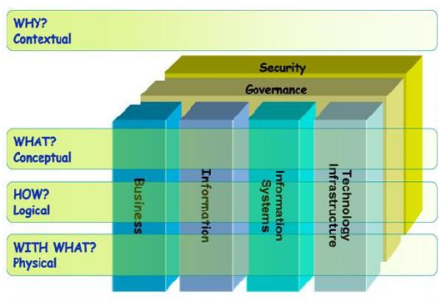
Learning analytics and the Enterprise architectural model
WHY
To support learning activity
To drive effectiveness in learning activities
To describe, predict, and improve business performance
WHAT
Learning analytics is the discovery, interpretation, and communication of meaningful patterns in data about our learners
HOW
Analytics often favors data visualization to communicate insight.
WHO IS “BUSINESS”?
Business in scope is learning support and delivery teams in OU and L&D teams across Group.
Source: http://talent.capgemini.com/global/pages/delivery/methods/iaftools/introduction_to_iaf/iaf_reference/

Slide 7
2016 Delivery Plan Learning Analytics
DRAFT
Implementation
Post Go Live Support and Planning for 2017
Sep
Oct
Nov
Dec
Jan
Feb
Activities and Deliverables
Scope clarification
L&D Analytics v2017
Launched
Jan 01
Alignment with other streams
Project portfolio work needed before Go Live
Stakeholder alignment (Other teams)
Hypercare
High Level Risks Criteria
No budget or decision on QV platform renewal – ITICS has flagged QV platform is stretched !

Slide 8
Analytics related project portfolio
Project | Transformation stream | Lead | Purpose / Scope | LEA (Learning Enterprise Architecture) focus ?
Evaluation of the learning function | Finance, budget & business impact | Lakshmi | Establish a Framework for evaluating the Business Impact of the Learning services provided in Capgemini | Conceptual & Logical layers (What and How) Business and information centric.
LPM Project | ? | Mindi | (To be verified) To implement a LPM Tool and define the right LPM process. To train teams to work with LPM. | All layers (why, what, how, with what), all aspects touched(Business,Information, systems, technology)
Category change | Learning Services | Peter | To update view per category of learning delivered | Logical Information & Information systems
(TBD) Analytical platform stabilization | TBD | TBD | To stabilize QV analytical platform, that according to GBI team is at the end of lifecycle (!) | Physical, logical IS & TI
DAL Tech Analytiics Substream | DAL Technology | Dennis | Scope technical solution and data strategy + implementation plan for Q4 and Q1 2017 | Physical, logical TI, IS, Information
Other projects not detailed at this point in time in a portfolio list: Zoho Decommisioning, Video Platform analytics, Social Learning Platform analytics, Talent Google analytics

Slide 9
Project portfolio – suggested High level phasing
Phase 1 – Analytics with Learning Architecture as-is, 2016-2017
Phase 2 – Updates based on new architecture (QV updated architecture, CMS, BPM, social learning, APIs, employee portal?), 2017
Phase 3 – Integrations for improved business insights, 2017+
AS-IS platform analytics
2016-2017
New architecture analytics
2017
Integrated analytics
2017+

Slide 10
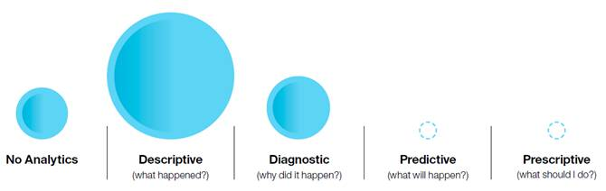
Where are we on the Analytics Journey started 2012/2013:
Framework done – EvaluateIt
Consistent implementation in the Group still TBD!
IT and IS systems – good position with group wide systems in Place (MyL / QV)
Last pockets of BU’s still not working consistently with LMS – so data not gathered
Erstwhile Igate units processes still to be transformed to leverage IT & IS available
DAL preparedness
Two worlds in Capgemini: India and RoW
Need a clear India ambition implemented and priotitized to enable DAL ambition analytics for Business impact
Need to develop a digital culture in all India L&D
Are wqe here?

Slide 11
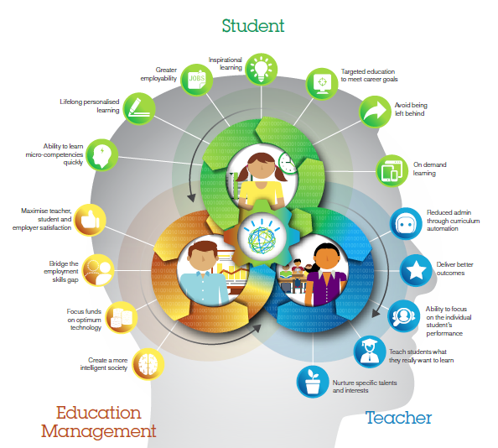
The IBM Learning Analytics Model for inspiration
IBM Learning analytics Model – focused on
Learners (Student)
Teachers (Facilitators)
Education Mangement (OU / L&D Management)
Insights / Ideas / Observations:
TBD
Idea: Link Learning data with HR Talent data (Job role, performance/potential), performace metrics (ARVE etc) to identify and recommend skill gaps to bridge
Source: Learning Analytics Education IBM.PDF

Slide 12
Suggested Learning Analytics Roadmap V1
DRAFT
Architectural layer
What to
Focus on
1. Analytical Culture
4. Reporting
5. Dimensions & Indicators
6. Systems / Data storage
7. Data capture
3. Analytics
2. Business insights and impact
Educate teams across ecosystem
HRO capability ramp up, QV dashboard push
Automate, self service, move to QV
To be decided when!
Develop for DAL, LPM and Impact measurement
Renew platform / architecture for scalability !
Automate, integrate, API’s, drive consistency

Slide 13
Select Architectural layers (3-7) detailed
DRAFT
5.
Dimensions & Indicators
Operational
Tactical
Strategic
Prescriptive
Predictive
DAL analytics requirements: Who/Where/what
Learning activity
Search
Behaviours
Operational
Dimensional (SBU/Country/Curriculum etc)
3.
Analytics
Frequency of capture/refresh
Impact evaluation !
Financial / HR / Procurement
7. / 6.
Data capture
&
Systems / Data storage points
MyLearning
Survey Gizmo
Operations dashboard (Tableau) / eNate/ BPM
iCompass
GFS / GPS / HFM / Salesforce / N2K
Video Platform
4.
Reporting
QV
Zoho
Survey Gizmo
Google Analytics
Reporting calatog / To be refreshed ?
AS-IS: Activity & trends
TO-BE Impact ?
Talent – Google analytics
Partner systems > API’s needed
CMS
HR data > from GDH / Corp Directory / MyPath / SAP
Ad-Hoc
To support requirement capture, estimation and ambition agreement linked to a plan & investment budget

Slide 14
Business stakeholders with Analytics / reporting requirements / For verification
DRAFT
OU/L&D Management
Business stakeholders
SBU’s / BU’s / SSC’s
Approach core teams
Shared service teams
Finance team
Other support teams
Group L&D and University Board
Learners ? – perhaps more indirectly!

Slide 15
Questions not handled at this point in time:
FROM LPM Project:
We are working on creating some predictive analytics reporting from the LPM Dashboard, in addition to simple red alert status reports
The analytics report model is being manually set up at this point, and I’d like this information included in the analytics stream requirements
My point about the ecosystem and interfaces is that there is a much broader enterprise topology which should be considered if we want real business insights to drive effectiveness (Suggestion from Peter: Anchor with Tech stream / Dennis & ITICS what roadmap is feasible?)
There is a list of standard business measurements someone (maybe in DAL paper) that should be reviewed to understand all the source systems (Peter: To be handled in Business impact project? Discuss with Lakshmi!)

Slide 16
Stream Charter / Analytics
Key outcomes
Deliverables
Key Success Factors
Driving global alignment in group learning ecosystem analytical capabilities and reporting platforms
A group level analyts centric enterprise architectural view
Updated Analytical Roadmap
Analytics enterprise architecture view
Coordination between initiatives and stakeholders driving forward analytical capability
Key Stakeholders
Group L&D,
OU Management
Itics
HRO
To be completed !
DRAFT to be further developed
In scope
Timelines
Business centric analytics
TDB
Scope clear October 1st 2017
Systems ready
Training plan / team ramp up
Lead & Team Members
LEAD :Peter .Tillegreen
Team members
Regis, Debbie, Frederic, Niyati (Herbie)
Out of scope
Predictive /prescriptive individual learner analytics / guidance
Notes:
In Scope:
Learning operations including:
Current HRO Scope
LMS admin (MyLearning Admin)
Reporting including compliance
Learning analytics
Level 1 learning evaluation (user feedback score)
Virtual session support
Certification tracking Service
Learning Information systems operations
New Operations scope
Learning Product management (course activity lifecycle -curriculum responsibility is out of scope)
LPM Monitoring and follow up actions
Global Learning contract management (admin)
Partner (strategic/growth/tool) admin
HRO VBP services governance
Global onboarding support
My essentials support

Slide 17
Support slides

Slide 18
Analytics defined (Wikipedia)
What
Analytics is the discovery, interpretation, and communication of meaningful patterns in data. Especially valuable in areas rich with recorded information, analytics relies on the simultaneous application of statistics, computer programming and operations research to quantify performance.
Analytics often favors data visualization to communicate insight.
Organizations may apply analytics to business data to describe, predict, and improve business performance.
How
Why

Slide 19
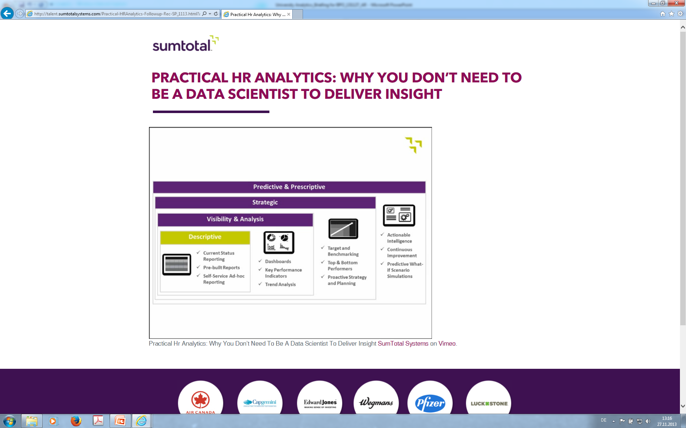
Analytics – What is it (2013/2014 View)
SumTotal Framework
Developing Collaborative Insights to Drive Business and People Impact
Notes:
A few slides giving further details on drill down, specific highlights which may be most relevant for SBU/Country or for the Quarter.
Will be very different for various entities.

Slide 20
HOW? - EvaluateIt

Slide 21
EvaluateIt - a 4-level evaluation framework
What already exists in capgemini
Relevance, Experience and Intent to apply
Like It
Knowledge Acquisition and Retention
Behavior and Individual Performance
Adoption and Business Performance
Know It
Show It
Impact It
Validated by external PhD

Slide 22
When to use each level of evaluation Note: All levels of evaluation will NOT be applied to all learning programs
Evaluation Level | Use
Like It | Aim for 100% of every learning program. There are different templates for each type of program: Face-to-Face (F2F) (also a University central event (BPW) version) Virtual classroom - one-time only Virtual classroom - session within a FVLJ Virtual classroom – end of FVLJ Program eLearning (proprietary and external (e.g., Skillsoft)) MOOC Conducted immediately after program completion (recommended)
Know It | Goal: 40% of learning programs measure this level Conducted a period of days or weeks of program completion Pre-req: Knowledge needs to be codified via methodology,a body of knowledge,book/resource, or profession is standardized within Capgemini (Account Manager, Enterprise Architect) Approach of a Pre-assessment/ Post-assessment may …… – when would you do this assessments are modular (a set of question for a topic) Primarily used for awareness or understanding learning objectives It tests a person has a minimum level of knowledge that we can recognize and is consistent across the organization Organizational support: dealing with exam results (response to fail/succeed) What does it mean when a person fails?
Show It | 10% (30% for F2F learning programs) Can be measured within a period of weeks or months after program completion Observe a change in behavioral performance at the individual level Metric to measure individual behavior change exist Learning objectives associated with demonstrating learning objectives Easiest measure is to ask the participant’s manager Supported by qualitative data, eventually supported by quantitative data Often executed through survey or interview if asking same audience for their view at different points in time, the question set must remain exactly the same each time
Impact It | 5% of learning programs We need to have access to the business KPI, either directly or through a delegate. Access to data that reflects activity 6 months to 1 year To assess business impact (rather than ROI) When it is a strategic initiative with large-scale implementation over a sustained period of time to demonstrate that the learning program has a business impact (business metric is viewed along with adoption. E.g., What is the % of certified EMs as compared to that area’s DVI?) Also may be associated with a large investments within the Group.
Notes:
Other levels of evaluation are not always cumulative (i.e., ‘Know it’ is not required in order to evaluate ‘Show It’

Slide 23
Evaluation Metrics
 | Measurement | Typical Evaluation Method | Templates
Like it | Qualitative comments and Quantitative rating 1-5 | Evaluation questionnaire and suggestions for how to do in classrooms on an on going basis. | new Evaluation templates
Know it | Exam Pass rate % Certification numbers | Exam Knowledge test | new Standard evaluation template
Show it | Individual KPIs Feedbacks from managers | Interviews 3 to 6 months after the program Individual KPI
Impact it (Blue Book) | Bookings DVI OTACE Hire2Assign ratio Time to billability Utilization – URVE Employee engagement Win rate Retention Service Levels (SLAs) Productivity metrics Internal promotions / external hiring | Data/KPIs collected as part of the operational processes of the organization. Adoption of the course in different business units is also analyzed Once or twice a year, a report can provide: Desk research (Data analyses like DVI, bookings and courses) Field research (Interviews, round table sessions)
Overall |  |  | new Findings Report template

